Slide 1
Healthcare Demo
CGSI Solutions Engineering
https://github.com/kevinbtalbert/Healthcare-Demo

Slide 2





SE Instructions: Setup and Deploy the AMP
DEMO COMPONENTS
Cloudera DataFlow
Launch the template from 1_nifi_cfm_assets/hl7-demo.json in DataFlow and deploy it. This will be used as the basis for the HL7 ingest/manipulation/extraction components of the demo.
Solr This is deployed by the AMP. The steps for this and CML in the last block will be the same. It is auto-deployed and set up by the AMP creation script. The most important thing to do is set up “Unauthenticated App Access” and THEN run the “Execute Solr Scripts” job created by the AMP. If these are done in reverse, the AMP will have no knowledge of the Solr instance and not be able to push data to its indexes.
Banana (Pluggable Framework/Dashboard)
This is all taken care of by the AMP scripts. Navigate to https://[CML APPLICATION]/solr/banana/src/index.html#/dashboard to view the Banana UI/Dashboard
Cloudera Machine Learning
To deploy the AMP, consider adding the catalog entry directly to the AMPs library: https://raw.githubusercontent.com/kevinbtalbert/Healthcare-Demo/main/catalog-entry.yaml
Otherwise, you can deploy the AMP referencing the repo itself: https://github.com/kevinbtalbert/Healthcare-Demo

Slide 3
Leveraging the Cloudera Data Platform for Healthcare Industries
DEMO COMPONENTS
Cloudera DataFlow
Ingest, extract, and manipulate HL7 data. Show routing capabilities of Cloudera DataFlow (NiFi) and streaming capabilities
Solr Solr is an open-source ,enterprise-search platform, written in Java. Its major features include full-text search, hit highlighting, faceted search, real-time indexing, dynamic clustering, database integration, NoSQL features and rich document handling.
Banana (Pluggable Framework/Dashboard)
Banana is a pluggable framework which acts as a dashboard for data indexed in Solr.
Cloudera Machine Learning
Leveraged to show how Generative AI can be brought into physician workflows and augment them for patient success.

Slide 4

Demo Inputs: What is HL7 Data?
What is HL7 Data?
HL7 is the messaging standard that enables interoperability and helps healthcare providers deliver better care. Health Level Seven (HL7) is a set of international standards used to provide guidance with transferring and sharing data between various healthcare providers.
MSH|^~\&|EPIC|EPICADT|iFW|SMSADT|199912271408|CHARRIS|ADT^A04|1817457|D|2.5|
PID||0493575^^^2^ID 1|454721||DOE^JOHN^^^^|DOE^JOHN^^^^|19480203|M||B|254 MYSTREET AVE^^MYTOWN^OH^44123^USA||(216)123-4567|||M|NON|400003403~1129086|
NK1||ROE^MARIE^^^^|SPO||(216)123-4567||EC|||||||||||||||||||||||||||
PV1||O|168 ~219~C~PMA^^^^^^^^^||||277^ALLEN MYLASTNAME^BONNIE^^^^|||||||||| ||2688684|||||||||||||||||||||||||199912271408||||||002376853
The MSH (Message Header) segment contains information about the message itself. This information includes the sender and receiver of the message, the type of message this is, and the date and time it was sent. Every HL7 message specifies MSH as its first segment.
The PID (Patient Information) segment contains demographic information about the patient, such as name, patient ID and address.
The NK1 (Next of Kin) segment contains contact information for the patient’s next of kin.
The PV1 (Patient Visit) segment contains information about the patient’s hospital stay, such as the assigned location and the referring doctor.

Slide 5
Demo Inputs: Patient Profile
What is HL7 Data?
HL7 is the messaging standard that enables interoperability and helps healthcare providers deliver better care. Health Level Seven (HL7) is a set of international standards used to provide guidance with transferring and sharing data between various healthcare providers.
MSH|^~\&|EPIC|EPICADT|iFW|SMSADT|199912271408|CHARRIS|ADT^A04|1817457|D|2.5|
PID||0493575^^^2^ID 1|454721||DOE^JOHN^^^^|DOE^JOHN^^^^|19480203|M||B|254 MYSTREET AVE^^MYTOWN^OH^44123^USA||(216)123-4567|||M|NON|400003403~1129086|
NK1||ROE^MARIE^^^^|SPO||(216)123-4567||EC|||||||||||||||||||||||||||
PV1||O|168 ~219~C~PMA^^^^^^^^^||||277^ALLEN MYLASTNAME^BONNIE^^^^|||||||||| ||2688684|||||||||||||||||||||||||199912271408||||||002376853
The MSH (Message Header) segment contains information about the message itself. This information includes the sender and receiver of the message, the type of message this is, and the date and time it was sent. Every HL7 message specifies MSH as its first segment.
The PID (Patient Information) segment contains demographic information about the patient, such as name, patient ID and address.
The NK1 (Next of Kin) segment contains contact information for the patient’s next of kin.
The PV1 (Patient Visit) segment contains information about the patient’s hospital stay, such as the assigned location and the referring doctor.

Slide 6
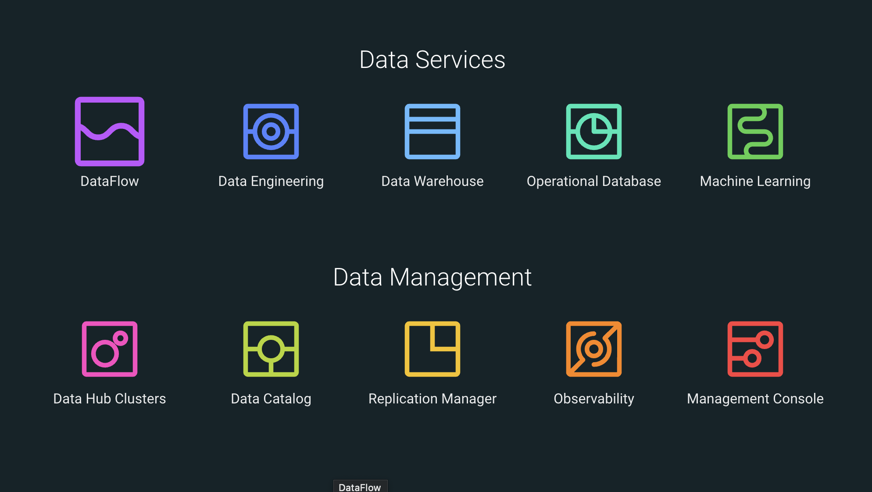

Slide 7

NiFi Data Ingestion and Routing Capabilities
Automated Data Retrieval:
Utilizes the InvokeHTTP processor to automatically retrieve data from external sources.
Data Transformation and Enrichment:
Employs processors like ReplaceText to modify and enrich the data.
Uses AttributesToJSON to convert data attributes to a JSON format.
Implements JoltTransformJSON to perform JSON-to-JSON transformations for more complex data manipulation.
Routing and Decision-Making:
Configures RouteOnAttribute to make decisions on how to handle data based on its attributes, ensuring that only data that meets certain criteria is processed further.
Processes like ExtractHL7Attributes are specifically designed to extract information from HL7 messages.
Data Output and Distribution:
The PutFile processor is used for outputting the transformed data to a file system or other destinations.

Slide 8
NiFi Data Processing and Error Handling
Data Validation:
GenerateFlowFile is set up to create valid HL7 messages for further processing.
Similarly, there's a flow for generating invalid HL7 messages to test error handling.
Error Handling and Logging:
RouteHL7 processor is used to differentiate between valid and invalid messages.
LogAttribute processor is configured to log details of data that cannot be matched or is deemed invalid.
LogInvalidData and LogUnmatchedData processors to log errors and unmatched data for review and debugging.
Data Routing Based on Content:
Demonstrates the use of content-based routing with RouteHL7 to separate valid and invalid messages.
The EnsureCarriageReturns processor is used to ensure message format compliance before routing.

Slide 9
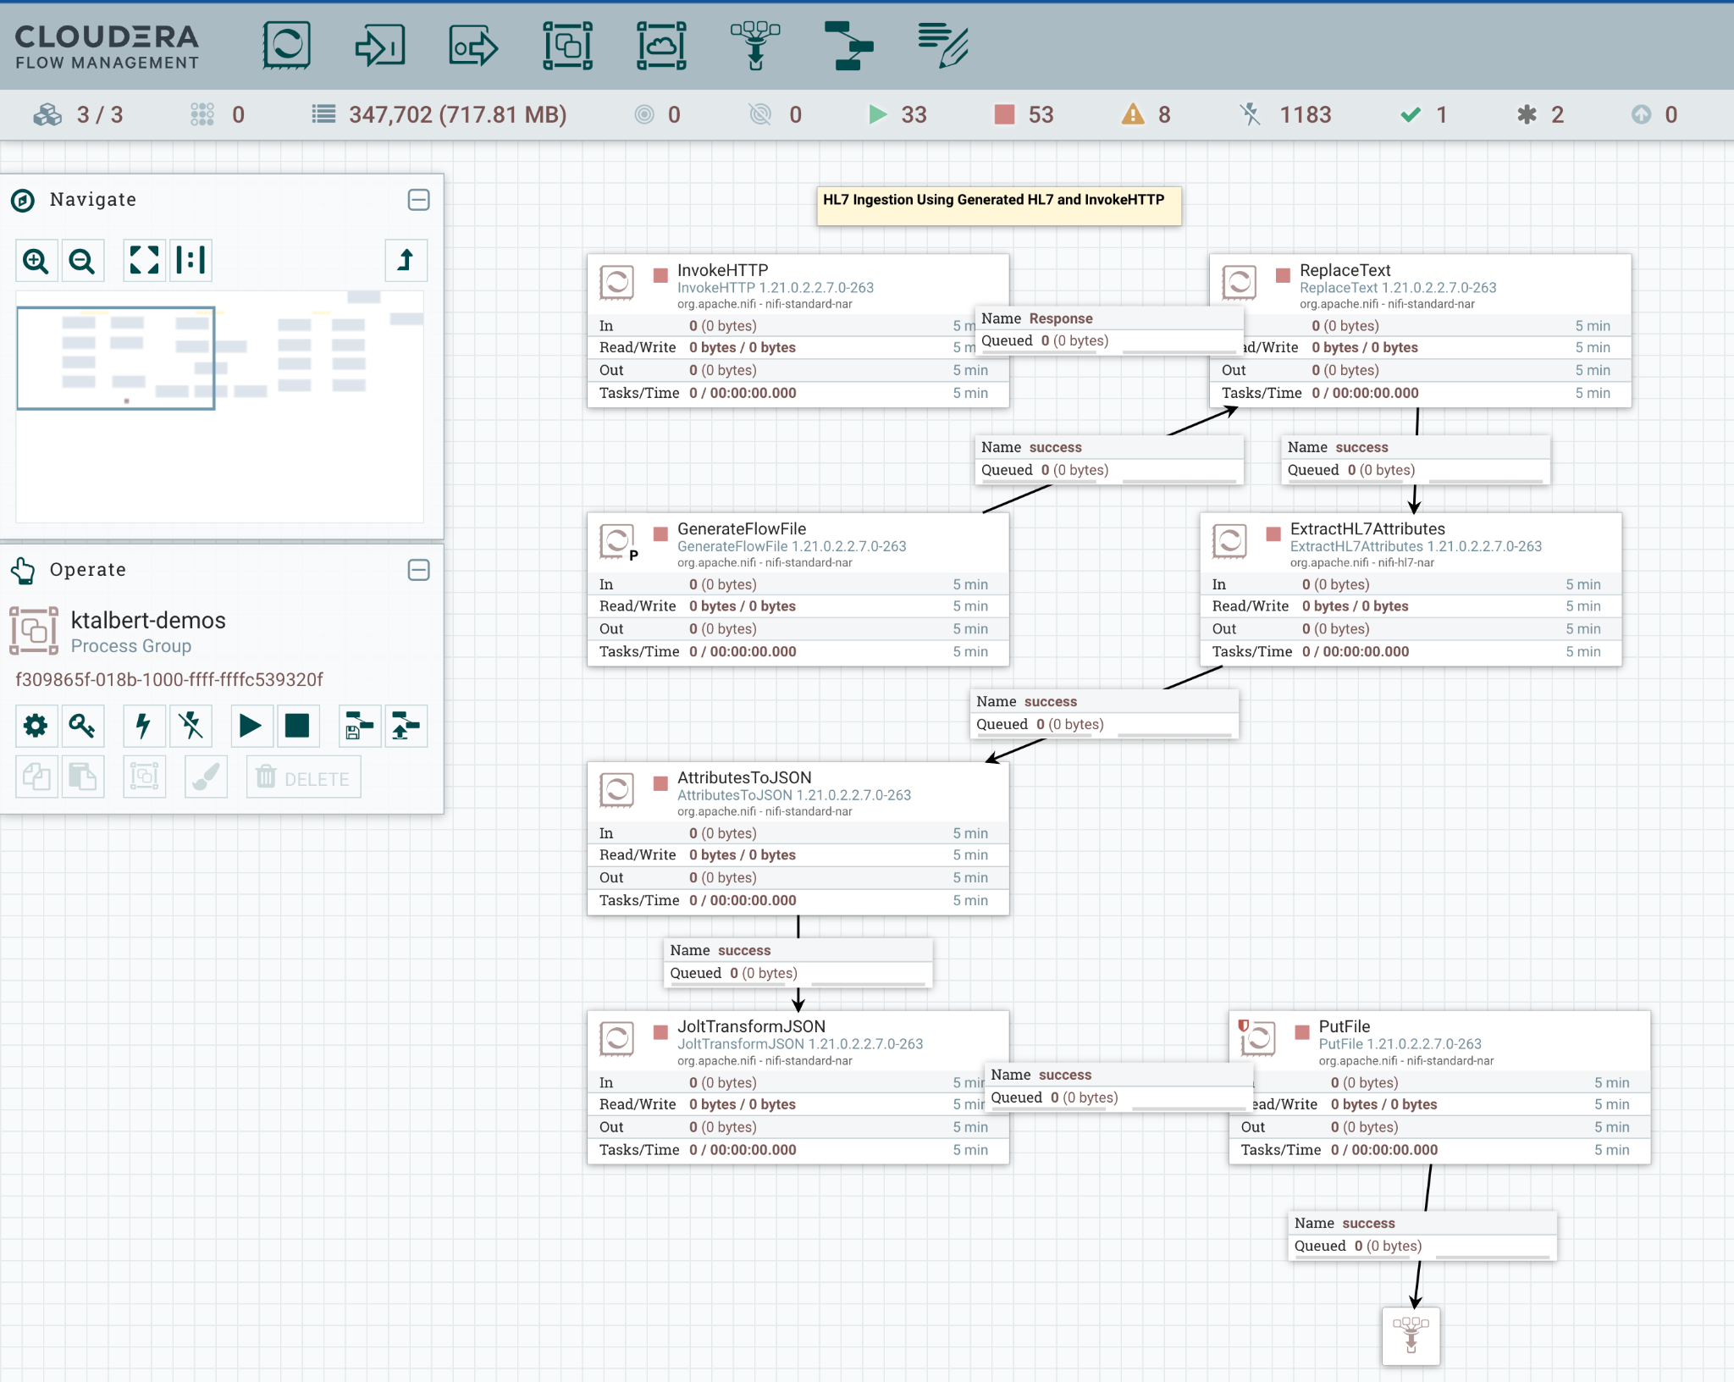

Slide 10
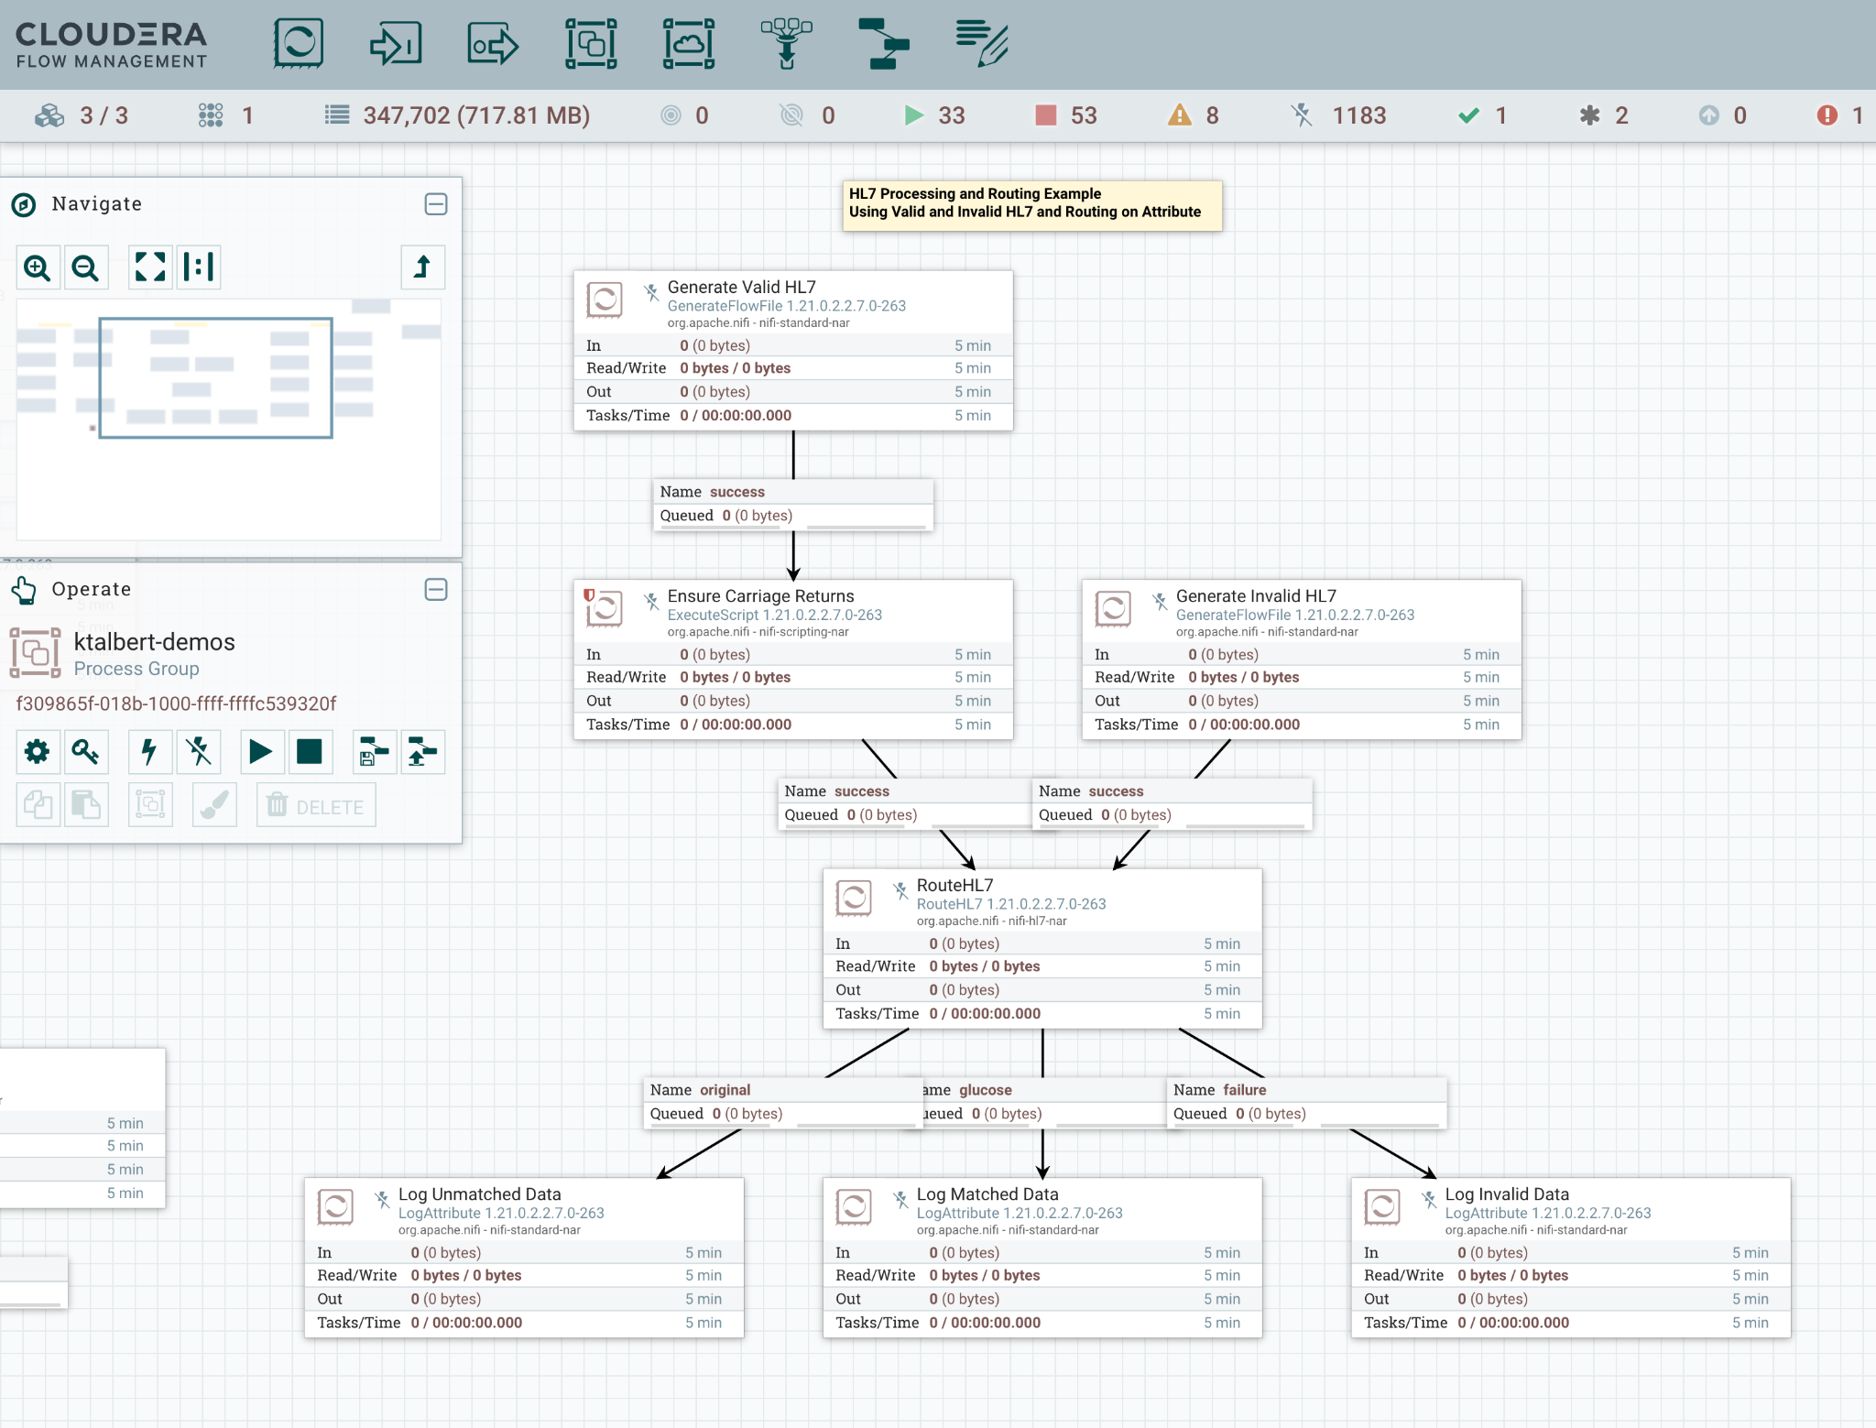

Slide 12
Leverage Solr and Banana UI to Visualize HL7 Data
Summary of Problem:
Because patients visit many doctors, trends in their ailments and complaints may be difficult to identify.
We will generate random HL7 MDM^T02 (v2.3) messages that contain a doctor's note about a fake patient and that patient's fake complaint to their doctor.
Visualizing Outcomes:
In the middle of the dashboard is a TagCloud where the more frequently mentioned symptoms for a selected patient appear larger than others. Because this project relies on randomly generated data, some interesting results are possible.
Other design considerations of interest are the way the dashboard will allow you to see timelines for patient’s intake, etc. Consider raising the number of sample patients ingested and the time frames to get a wider range of random data. By default we use 50 patients as a subset example.
Design Considerations:
In Solr, we leverage stopwords (examples: adjustments, admitted, because, blood, changes, complained, discharged) to eliminate superfluous data from our visuals.
In productionizing this design, we could consider using NiFi to directly push to Solr using PutSolrContentStream.

Slide 13
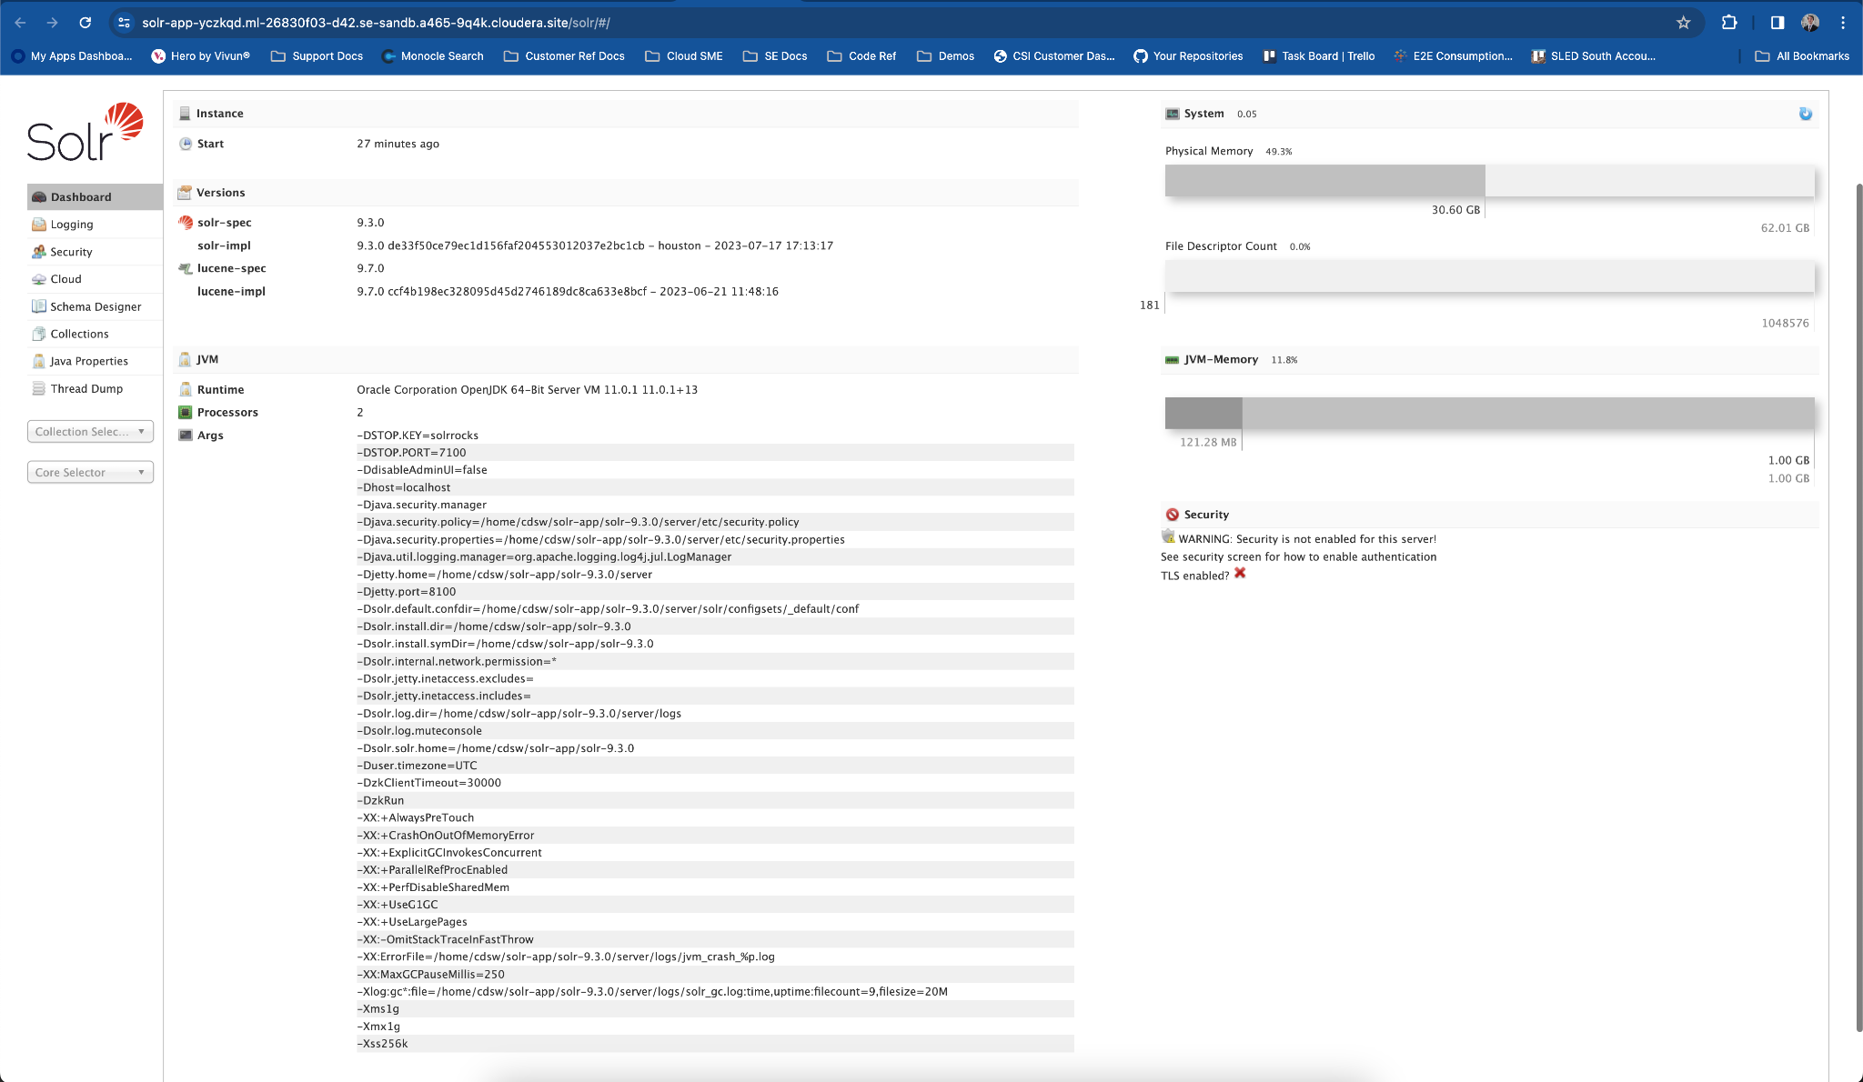

Slide 14
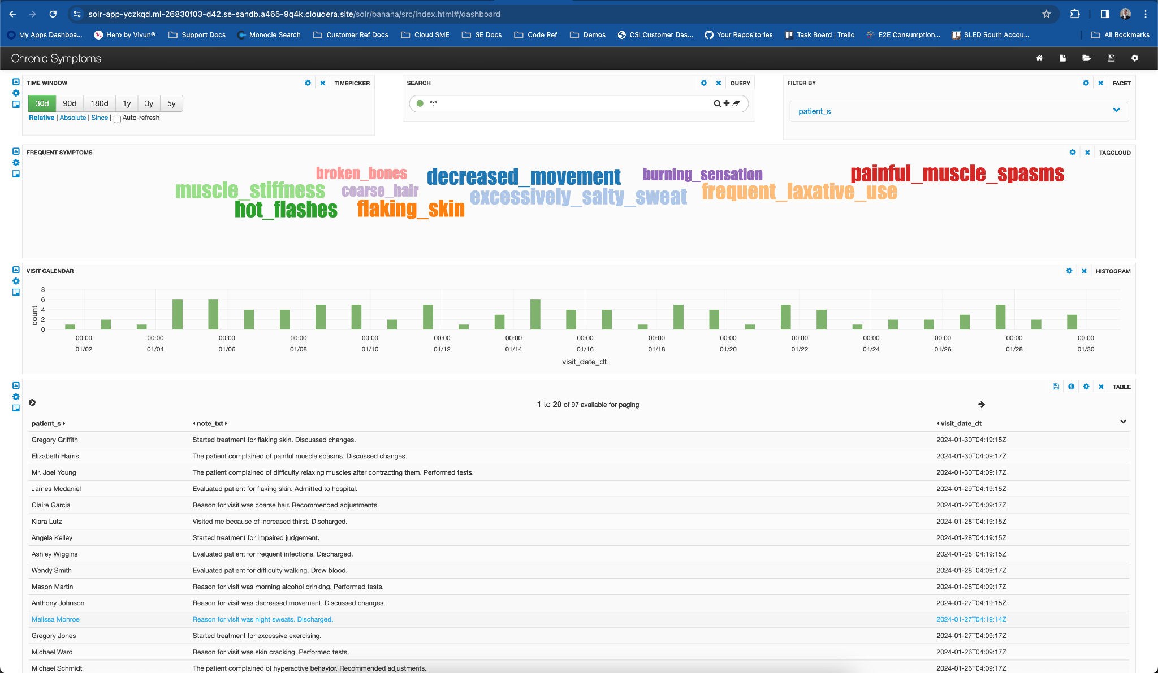

Slide 16
Generative AI Outcomes for Augmenting Physician Workflows
AI-Powered Recommendations: The portal uses AI to provide immediate suggestions and recommendations based on the patient's health data.
Interactive Query System: Physicians can type in specific questions or select from a list of predefined questions to quickly access relevant information.
Patient Data Integration: The system integrates patient profiles, including medical history, conditions, medications, and allergies, to tailor AI responses.
Generative AI for Custom Advice: AI generates custom advice based on the patient’s specific health data and presented queries, ensuring personalized care suggestions.
Healthcare Provider Confirmation: The AI's suggestions are designed to be confirmed by healthcare providers, ensuring a dual-check system for patient care.
Comprehensive Care Suggestions: AI covers a wide range of care suggestions, from lifestyle changes like diet and exercise to mental health support such as therapy.
Patient-Specific Insights: AI suggestions are not generic but tailored to the individual, taking into account their unique health profile and treatment history.
Support for Decision Making: Provides a preliminary diagnosis and suggestions for improvement, aiding in the physician’s decision-making process.

Slide 17
